Slide 1
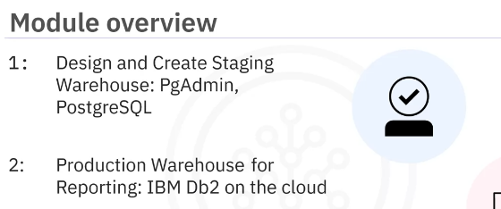
Data Warehouse
Week-3
In this module you will design and implement a data warehouse and you will then generate reports from the data in the data warehouse.
Learning Objectives
Design a Data Warehouse using the pgAdmin ERD design tool.
Load data into a Data Warehouse.
Write cube and rollup aggregation queries.
Create Materialized Views (/MQTs).
you will perform a couple of assignments.
In the first assignment covered in this video, you will design and create a staging data warehouse environment using PgAdmin and PostgreSQL.
In the second assignment, covered in the next video, you will deploy the production Warehouse for reporting purposes using Db2 on Cloud.

Slide 2
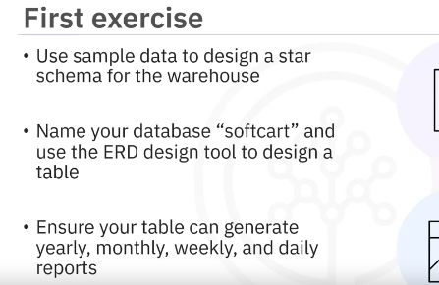
The first exercise in this assignment requires you to design a data warehouse.
The e-commerce company has provided you with sample data and you will start your project by designing a star schema for the warehouse by identifying the columns for the various dimension and fact tables in the schema.
You will name your database “softcart” and then use the ERD design tool in PgAdmin to design the table softcartDimDate using fields such as DateID, Month, Monthname, and so on.
And the company would like to have the ability to generate reports on a yearly, monthly, weekly, and daily basis.

Slide 3
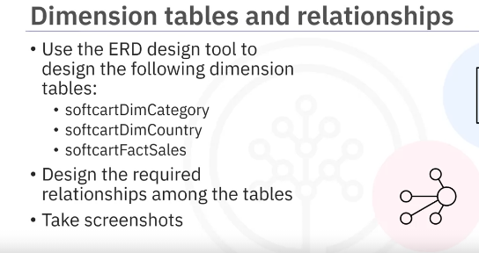
You will use the ERD design tool to design the dimension tables softcartDimCategory, softcartDimCountry, and softcartFactSales.
You will also use the ERD design tool to design the required relationships (for example, one-to-one, one-to-many, and so on) among the tables.
And finally, after performing each task, you will take a screenshot of the entire ERD, clearly showing all the field names, data types, and relationships among the tables.

Slide 4
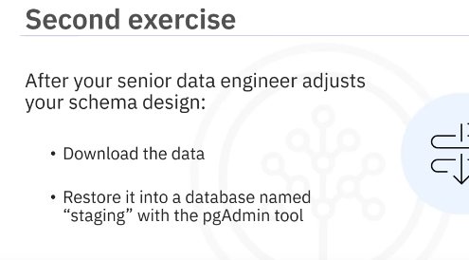
In the second exercise, you will load the data into the data warehouse.
Your senior data engineer reviews your design and makes a few improvements to your schema design.
The data, as per the improved schema, is available at a link.
You will download the data and restore it into a database named “staging” using the pgAdmin tool.

